Slide 1














Investment Analysis

Slide 2
Overview
Dataset Scope: Captures investment decisions and opinions of 40+ individuals on various financial instruments
Instruments Covered: Includes Fixed Deposits, Government Bonds, Mutual Funds, Public Provident Funds, Debentures, etc
Insights Provided: Highlights preferences, risk tolerance, and investment objectives across key financial products

Slide 3
Business Analysis of
Finance Sector

Slide 4

SWOT ANALYSIS
S
W
✔ Robust regulations
✔ Diverse and accessible
✔ Products High investor trust
✔ Limited awareness of complex products
✔ Over-reliance on traditional investments
✔ Risk aversion hindering high-return opportunities
O
T
✔ Rising demand for digital services
✔ High focus on retirement and long-term wealth
✔ Expansion of alternative investments like REITs and ESG funds
✔ Economic volatility
✔ Rising competition from fintech startups
✔ Global economic downturns impacting returns

Slide 5
Porter's Five Forces Analysis
Threat of New Entrants
Bargaining Power of Suppliers
Bargaining Power of Buyers
Threat of Substitutes
Industry Rivalry
Intense competition among financial institutions, fintech companies, and traditional investment firms
High capital and regulatory requirements limit entry, but fintech innovations are lowering barriers
Investors have access to a wide range of investment options and can easily switch providers
Alternatives like real estate or cryptocurrency are emerging, but traditional finance remains dominant
Many investment products and services are standardized with limited differentiation
Moderate
Low
High
Moderate
High

Slide 6






Pestle Framework
Political
Economic
Social
Stable political environment, but sensitive to policy changes affecting taxes and interest rates
Impact of economic cycles on investment returns, interest rates and inflation are key factors
Growing financial literacy and interest in wealth creation among younger demographics
Technological
Legal
Environmental
Rapid adoption of fintech solutions and digital platforms for investment management
Stringent regulations governing financial products and services to protect investors
Increasing investor interest in sustainable and socially responsible investment options

Slide 7
GAP Analysis
Current State
Desired State
Identified Gaps
High investor reliance on traditional, low-risk investment options like PPF and Fixed Deposits
Increased diversification into high-return investments like equities and alternative assets
Lack of investor education on high-return opportunities and Limited product offerings tailored for risk-tolerant and tech-savvy investors

Slide 8
3C Framework
Customer
Company
Competitors
Predominantly risk-averse, with a strong preference for safe and tax-efficient investments
Financial institutions with established trust, offering a broad range of traditional and digital products
Growing competition from fintech startups and alternative investment platforms challenging traditional institutions

Slide 9

Dataset Analysis

Slide 10
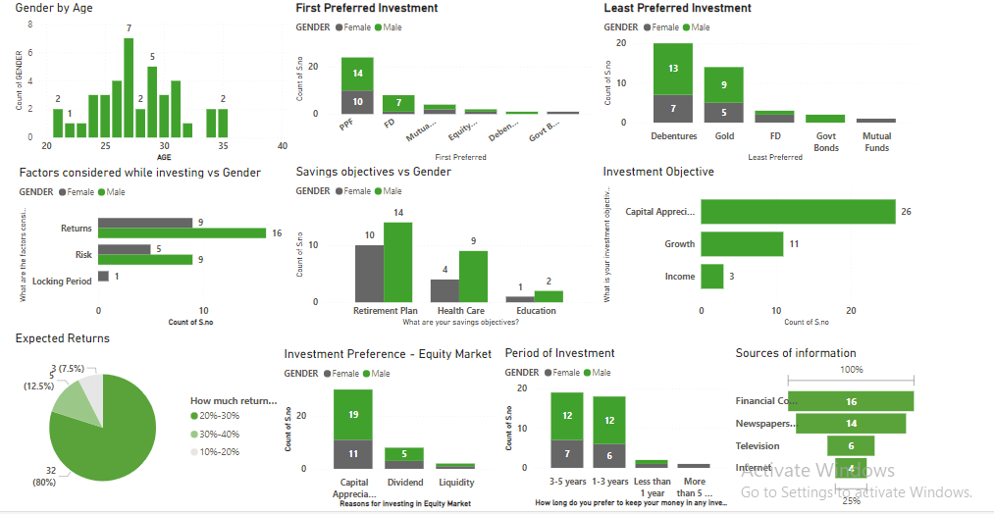
Consolidated PowerBI Dahsboard

Slide 11
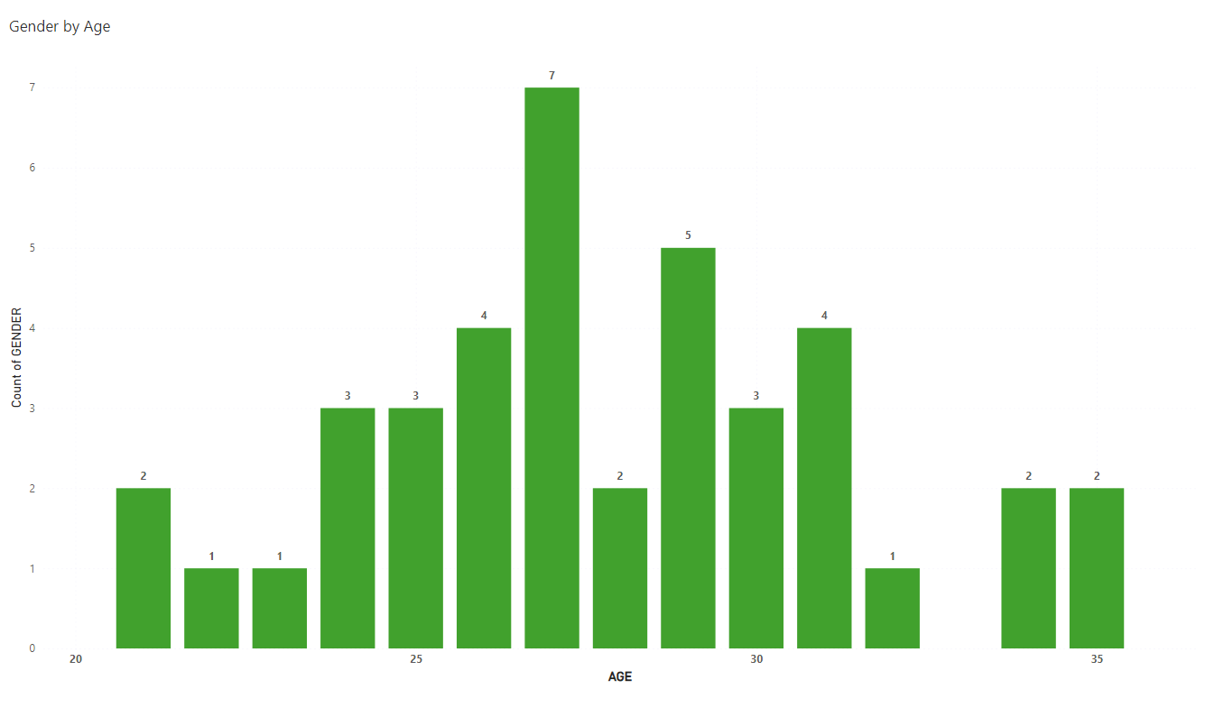
Demographic Analysis
Insight:
A significant portion of investors are aged 25-30
Recommendation:
Tailor made marketing strategies and investment products can be used to target younger investors
We can provide awareness by introducing educational content to help them make informed investment decisions

Slide 12
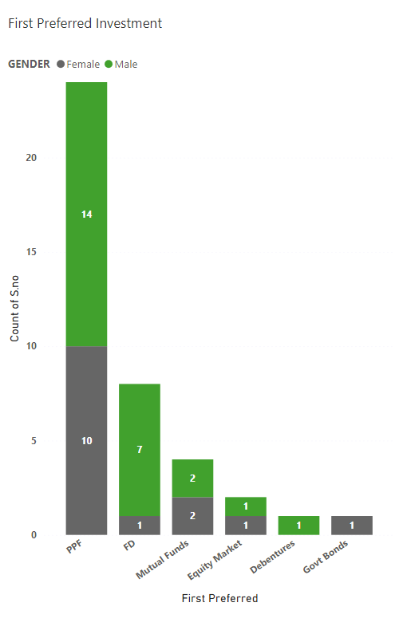
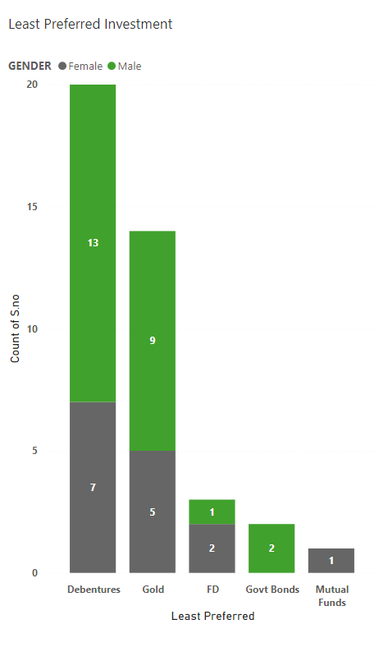
Investment Preferences
Insight:
PPF is the top choice, while Debentures are least preferred
Recommendation:
We should promote PPF as a stable investment option, highlighting its tax benefits.
For debentures, we should consider educating investors on their benefits and potentially restructuring them to make them more appealing

Slide 13
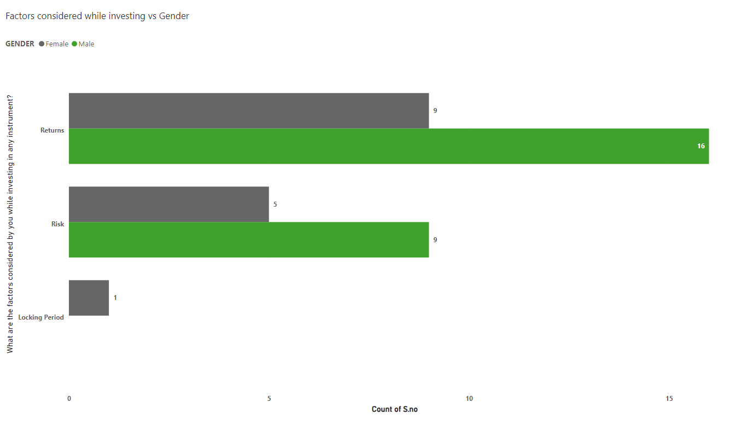
Factors Influencing Investment Decisions
Insight:
Most investors prioritize returns, while a smaller group is concerned about risk
Recommendation:
Offer diversified investment portfolios that balance high-return instruments with lower-risk options
Provide tools or services to help investors assess risk more effectively

Slide 14
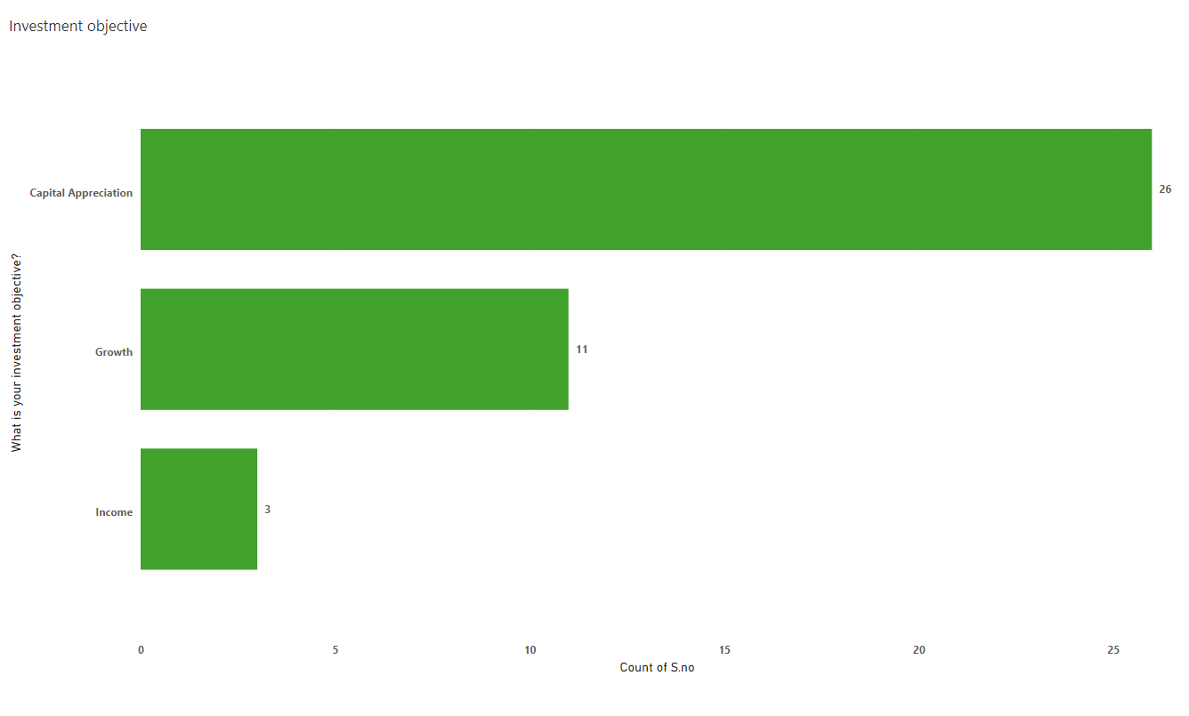
Investment Objectives
Insight:
Wealth creation is the primary goal for most investors, followed by retirement planning
Recommendation:
Design and market investment products that emphasize long-term wealth creation, such as equities and mutual funds
Also go along with retirement-focused options like PPF and Fixed Deposits

Slide 15
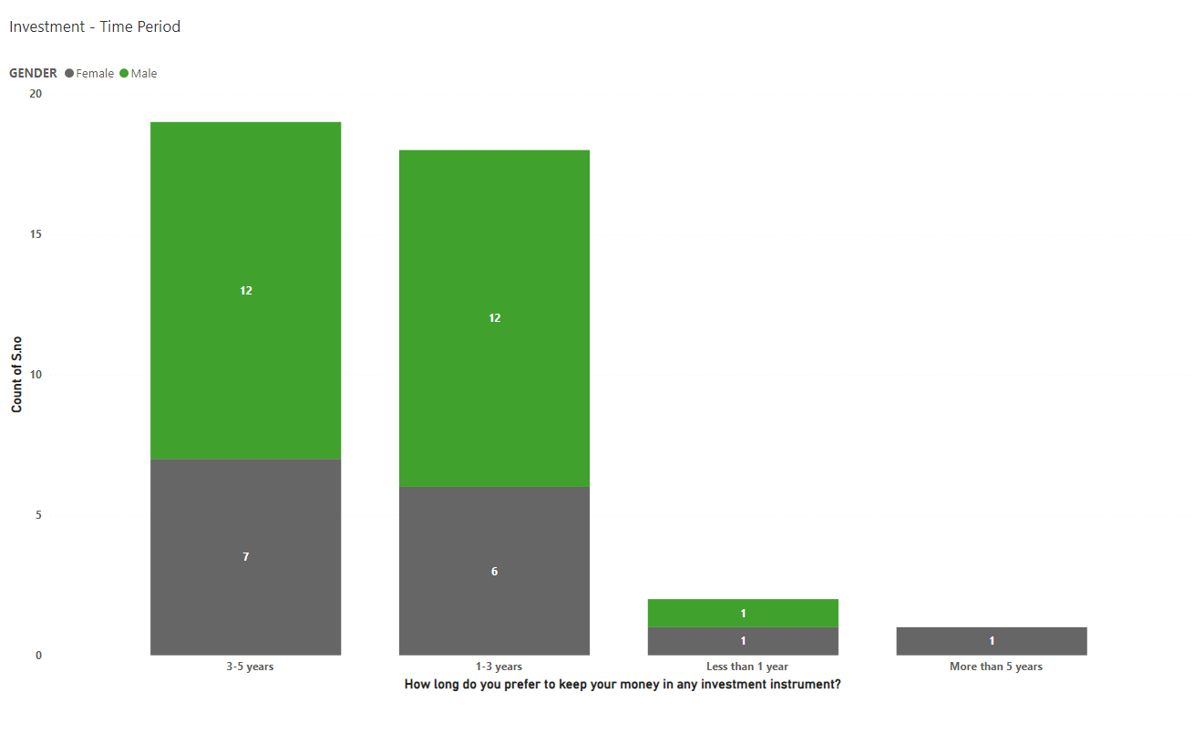
Duration Preferences
Insight:
Investors prefer medium-term (3-5 years) investments, followed by short-term (1-3 years)
Recommendation:
Develop and promote investment products that cater to these preferred time frames, such as short- and medium-term bonds or target-date funds

Slide 16
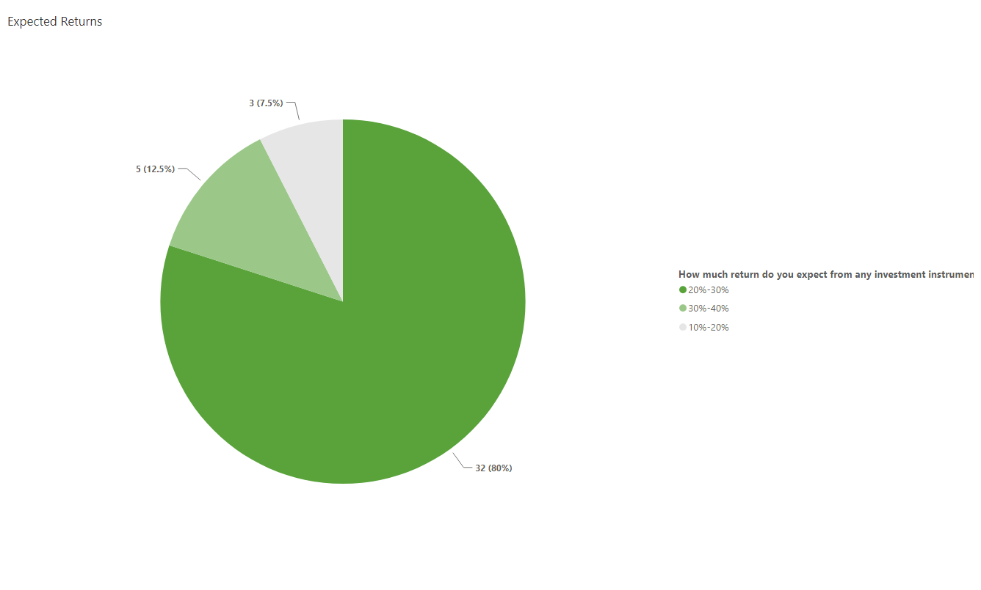
Return Expectations
Insight:
Most investors expect returns in the range of 20-30%
Recommendation:
Set realistic expectations by providing clear communication about the potential returns of different investment avenues
Offer products that align with these expectations, such as equity-linked savings schemes (ELSS) or balanced funds

Slide 17
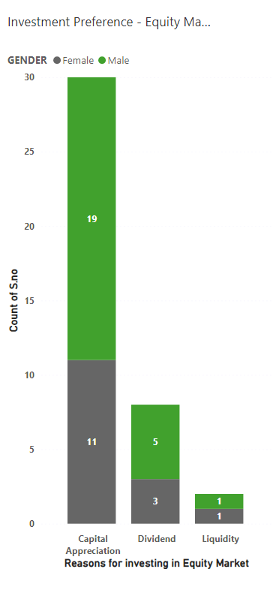
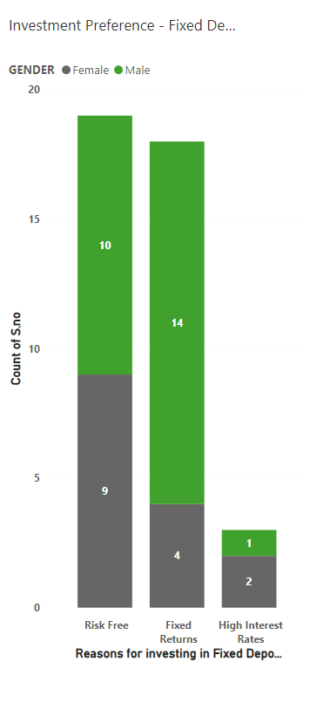
Equity Market Sentiment
Fixed Deposit Popularity
Insight:
Insight:
Investors are attracted to the equity market primarily for high returns, with dividends as a secondary motivator
Fixed Deposits are favored for their risk-free and guaranteed returns
Recommendation:
Recommendation:
Continue promoting Fixed Deposits as a safe investment option, but consider introducing innovative products like laddered Fixed Deposits or fixed income mutual funds to maintain interest
Highlight the potential for high returns in equities while offering options with strong dividend yields to attract income-focused investors

Slide 18
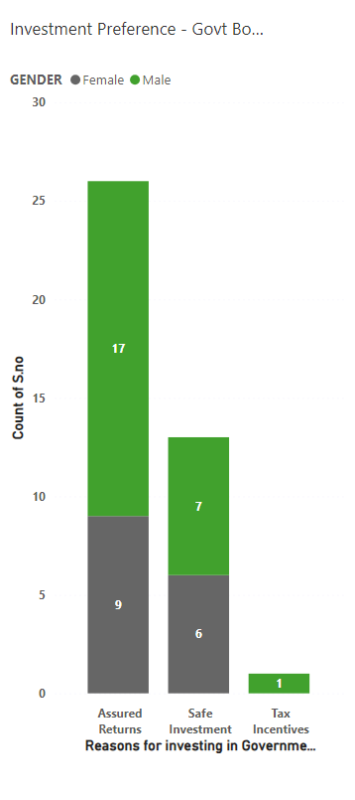
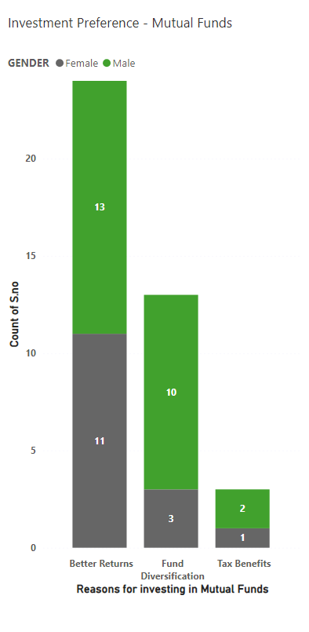
Government Bonds Trust
Mutual Funds Popularity
Insight:
Insight:
Government bonds are trusted due to their government backing and risk-free nature
Mutual Funds are favored for their long term growth factor and diversified investments
Recommendation:
Recommendation:
Promoting Systematic Investment plan (SIP) among younger generations can help them to start their investment journey. This would also cater their long term goals including Health and other retirement planning.
Leverage the trust factor by promoting government bonds as part of a diversified investment strategy, especially for conservative investors

Slide 19
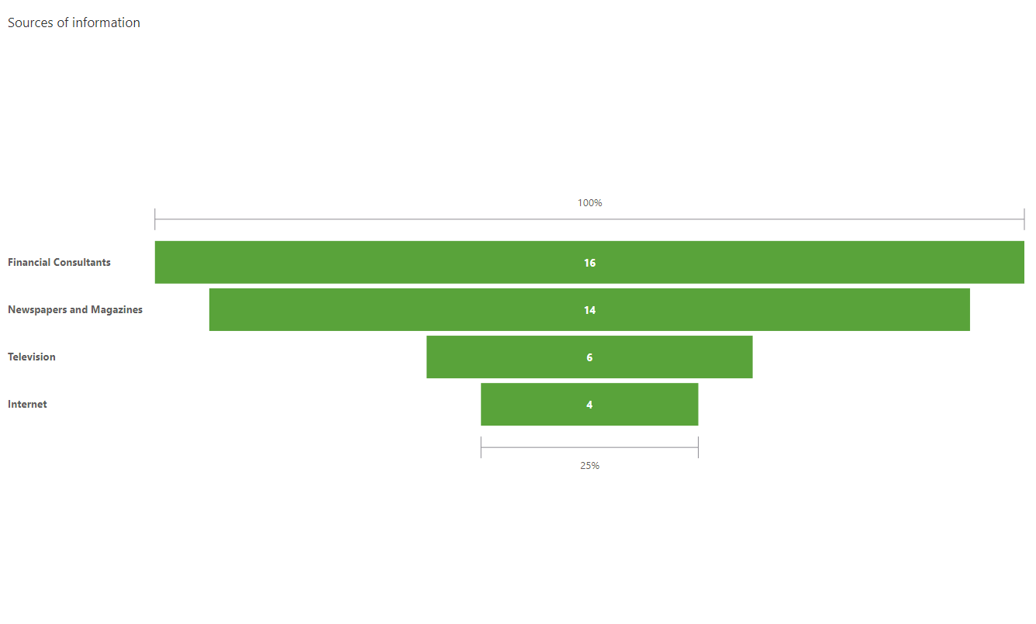
Source of Investment Knowledge
Insight:
A significant portion of investors rely on financial consultants, newspapers, and magazines for information
Recommendation:
Strengthen relationships with financial consultants and consider content partnerships with trusted media outlets.
Provide online resources and webinars to reach a broader audience

Slide 20




Other Recommendations
Retirement Planning
Investment Monitoring
Retirement is a key motivator for long-term investments
Offer retirement planning tools and personalized advice to help investors align their investment strategies with their retirement goals
Understanding how often investors monitor their investments can reveal engagement levels
Develop tools and apps that allow investors to easily monitor and manage their investments, offering alerts and insights based on their monitoring habits
Tax-Free Investment Options
Alternative Investment Opportunities
PPF and Fixed Deposits are preferred for their tax-free benefits
Promote these tax advantages in marketing materials and consider offering similar tax-efficient investment products to attract more investors
Gold and other alternative investments could be explored further
Educate investors on the benefits of diversifying into alternative investments like gold, real estate, or REITs, especially during times of market volatility

Slide 21




An Analysis by
Mohamed Afsar
BADM - MB26

